Slide 1


Slide 2
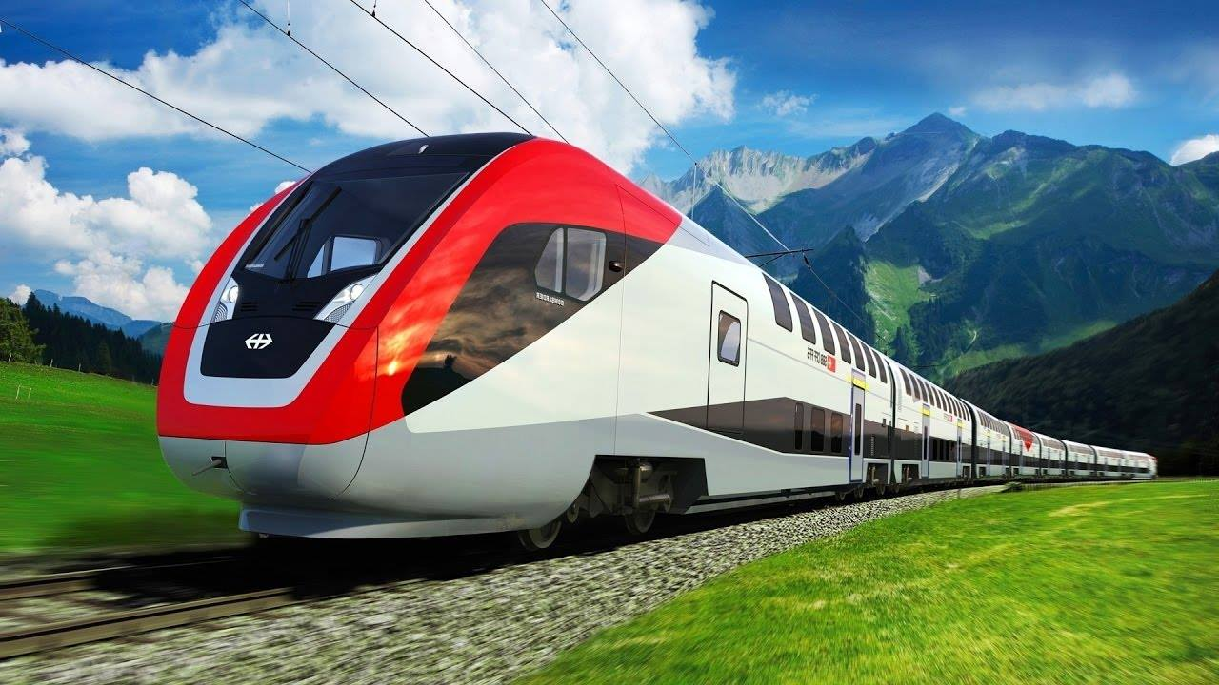
Welcome to MRT system
( Metro Rail Transportation)
Main Menu

Slide 3
Please Select
Main Menu
Admin
Passenger

Slide 4
Please Select
Main Menu
Passenger
Sign Up
Sign In
Main Menu

Slide 5
Create account
Main Menu
Passenger
Sign Up
Full Name
NSU ID
Gender
Phone Number
E-Mail
Occupation
Password
Confirm Password
Back
Main Menu

Slide 6
Sign In
Main Menu
Passenger
Sign In
Phone No.
Password
Back
Main Menu

Slide 7
Welcome !
Main Menu
Passenger
Sign In
Information
Name
NID
Age
Just print
Gender
Occupation
Back
Main Menu

Slide 8
Please Select
Main Menu
Passenger
Sign In
Information
Student
Buy online Ticket
Book online Ticket
Payment Method
Back
Main Menu

Slide 9
Buy online ticket
Main Menu
Passenger
Sign In
Information
Student
Buying Ticket
Start Location
End Location
Date
Time
No. of Passengers
Total Cost
Payment
Successful !
Back
Main Menu

Slide 10
Book online ticket
Main Menu
Passenger
Sign In
Information
Student
Booking Ticket
Start Location
End Location
Class
Date
Time
No. of Passengers
Total Cost
Back
Main Menu

Slide 11
Payment Method
Main Menu
Passenger
Sign In
Information
Student
Method of payment
Bkash
PayPal
Credit Card
Others
Enter transaction ID
Back
Main Menu

Slide 12
Please Select
Main Menu
Passenger
Sign In
Information
Civilian
Buy a Ticket
Book a Ticket
Method of Payment
Back
Main Menu

Slide 13
Buy online ticket
Main Menu
Passenger
Sign In
Information
Civilian
Buying Ticket
Start Location
End Location
Class
Date
Time
No. of Passengers
Print Total Cost
Payment
Confirmation Code
Successful !
Back
Main Menu

Slide 14
Book online ticket
Main Menu
Passenger
Sign In
Information
Civilian
Booking Ticket
Start Location
End Location
Class
Date
Time
No. of Passengers
Print Total Cost
Back
Main Menu

Slide 15
Admin
Main Menu
Admin
Log In
Back
Main Menu

Slide 16
Log in
Main Menu
Admin
Log In
NID
Password
Back
Main Menu

Slide 17
Please Select
Main Menu
Admin
Log In
Hello !
Update Notice
Update Cost
Back
Main Menu

Slide 18
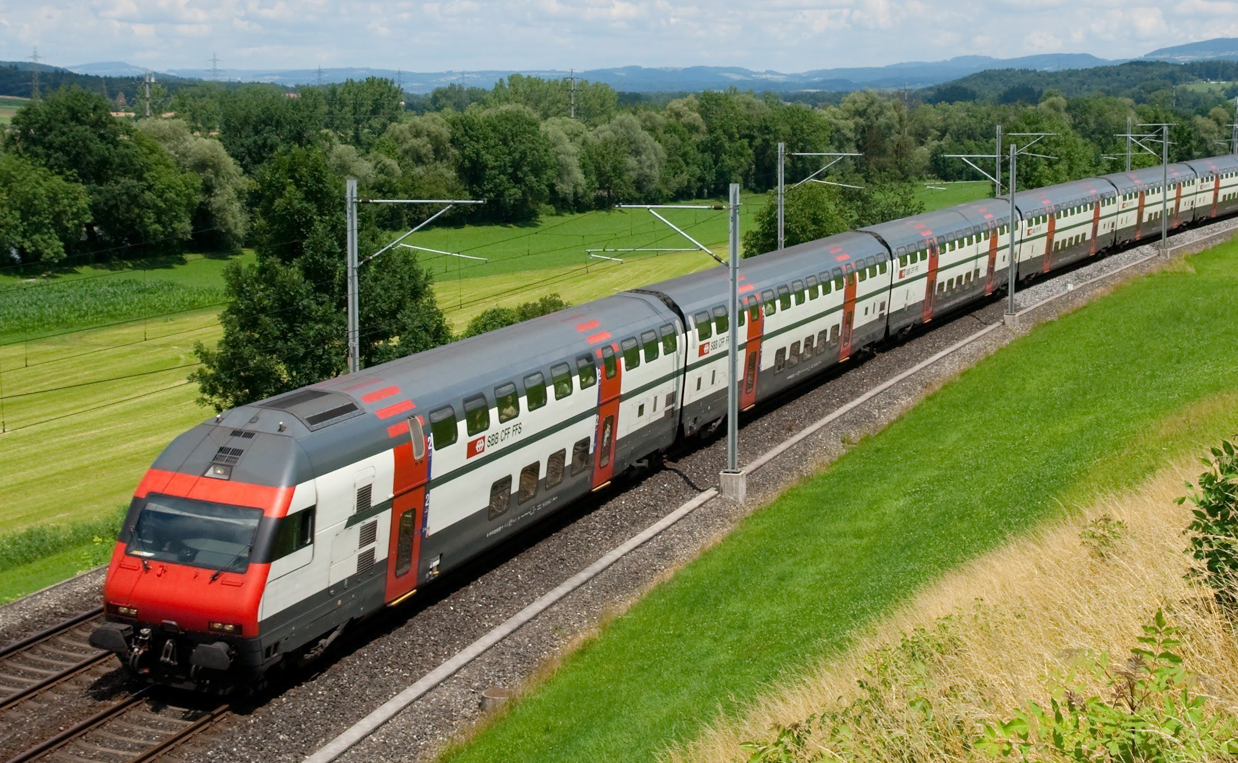
Thanks for watching !
Created by
Group IV

